Slide 1
Data-Driven Predictions for Startup Success
By: David Yang, Fernando Castaneda, and Kevin Yao

Slide 2
Project Overview:
We aim to develop predictive models using logistic regression, decision trees, and random forests to evaluate the potential success of startups based on historical data and key business metrics. This approach will help investors and entrepreneurs make informed decisions by identifying critical success factors and predicting future outcomes.

Slide 3
Value Proposition
Our analytical approach, using the "Startup Investments" dataset, enables investors and entrepreneurs to identify key success factors and forecast the viability of startup ventures with greater accuracy. By focusing on relevant metrics and factors that contribute to startup success, stakeholders can strategically allocate resources, minimize risks, and maximize returns in the competitive startup ecosystem.

Slide 4
Dataset
We utilized the "Startup Investments" dataset, published by Justinas Cirtautas on Kaggle, which comprises 11 individual datasets detailing various factors potentially influencing startup success. In our analysis, we selectively extracted data pertinent to our defined success metrics from these datasets.

Slide 5
Dataframes
objects_df = pd.read_csv("objects.csv") - Main Dataframe
degrees_df = pd.read_csv("degrees.csv") - Merged
funding_rounds_df = pd.read_csv("funding_rounds.csv") - Merged
milestones_df = pd.read_csv("milestones.csv") - Merged
relationships_df = pd.read_csv("relationships.csv") - Merged

Slide 6
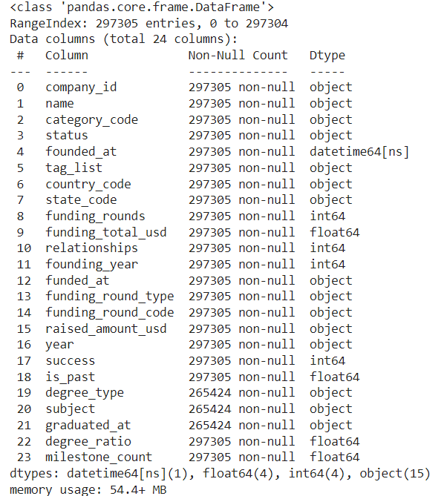

Slide 7
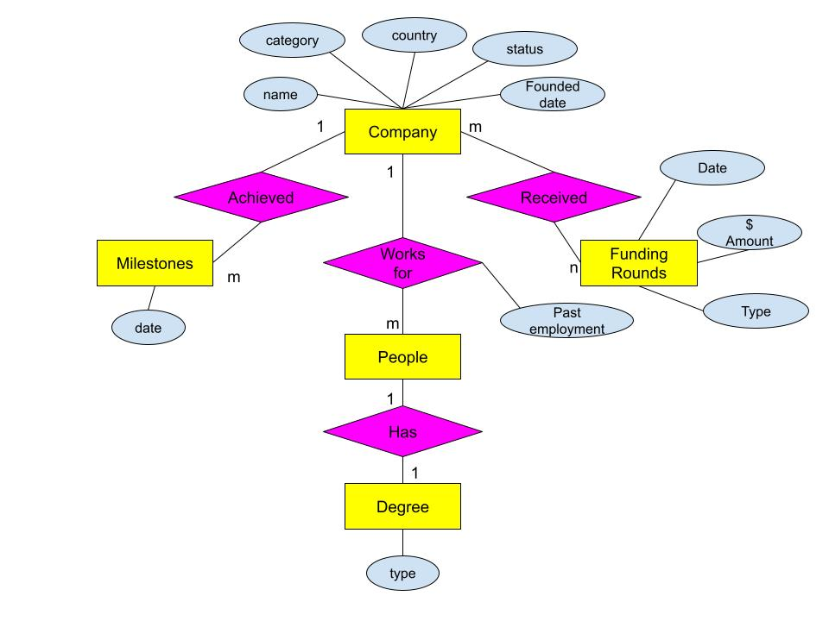

Slide 8
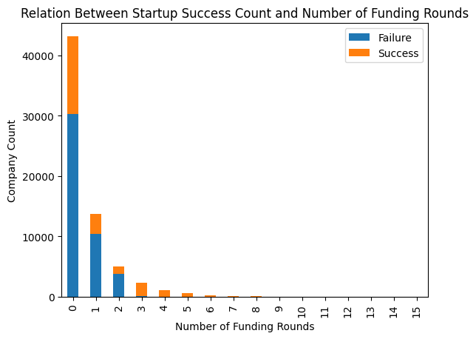
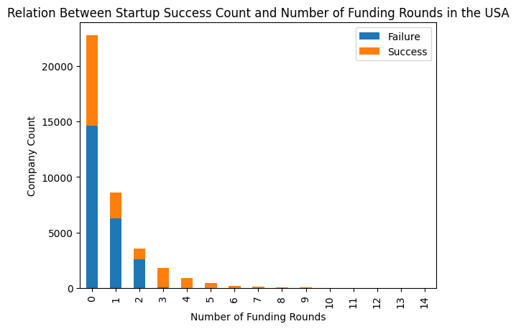
Key Takeaways:
We can see that companies with at least 3 funding rounds have very small chances of closing, and thus are worthwhile investments. This additionally means that we chose a good success metric to work with.
Companies that have less than 3 rounds of funding may not be a worthwhile investment.
Companies without funding rounds do better than those that get one or two.
Notes:
We can see that companies with this many funding rounds have very small chances of closing, and thus are worthwhile investments. This additionally means that we chose a good success metric to work with.
this suggests a private backer in companies with zero funding rounds, or possibly some other influence not represented by our dataset.

Slide 9
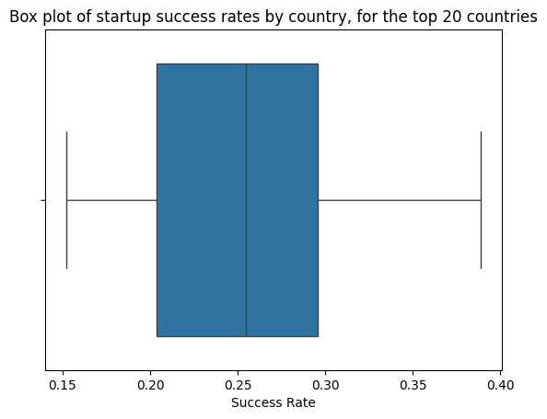
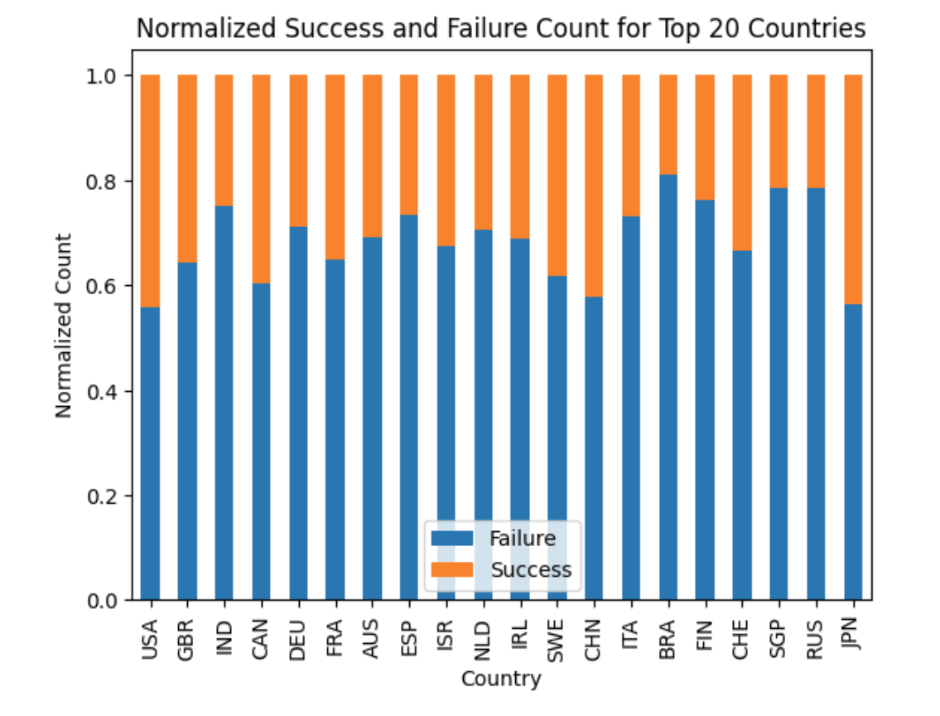
Key Takeaways:
Even in countries with high numbers of startups, startup success is still not very common.
We see higher rates in the US and Japan, with relatively decent rates in European countries.
There aren't any countries with a substantially better performance than other ones. Because of how much dimensionality we are adding through this categorical column, we will opt to not include it when training our model, as country's effect on success is not large enough.

Slide 10
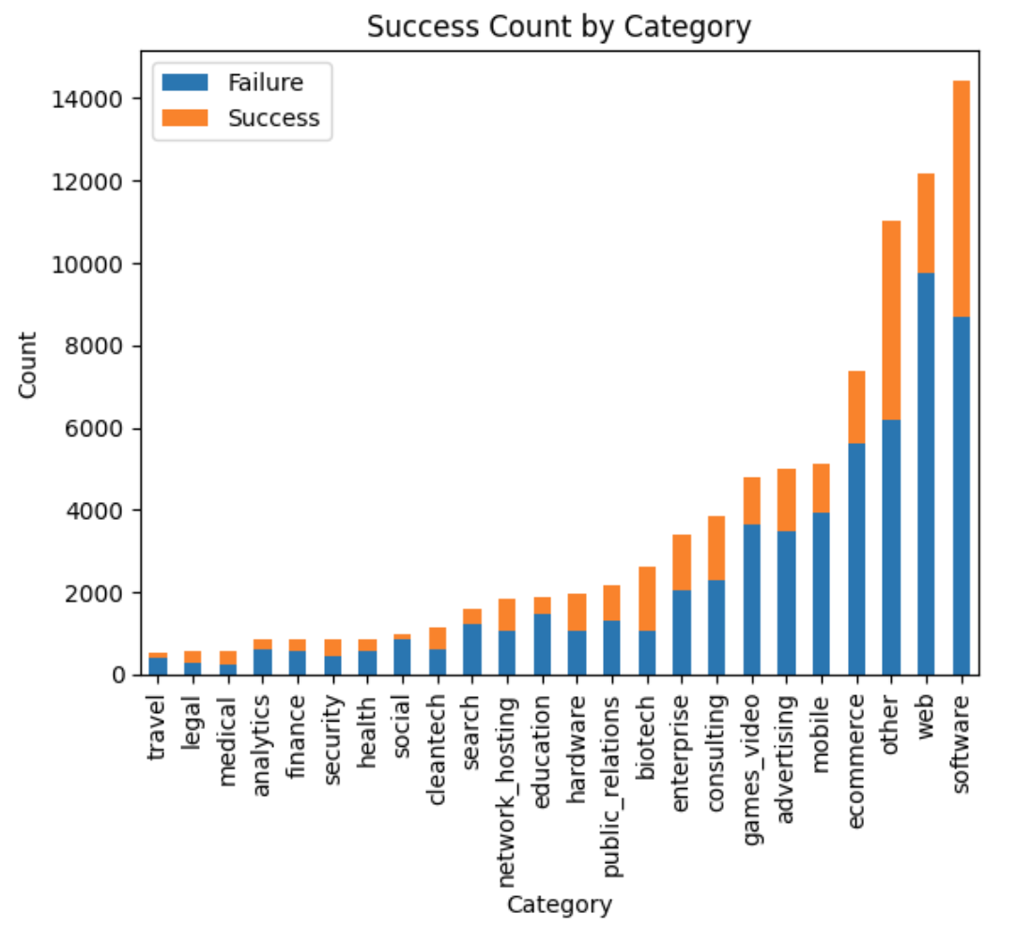
Key Takeaways
The most frequent startups are those that are tech related, specifically web and software.
By sector, most successful sectors include hardware, biotech, and medical. Thus, when considering investor ROI, these industries perform the best.

Slide 11
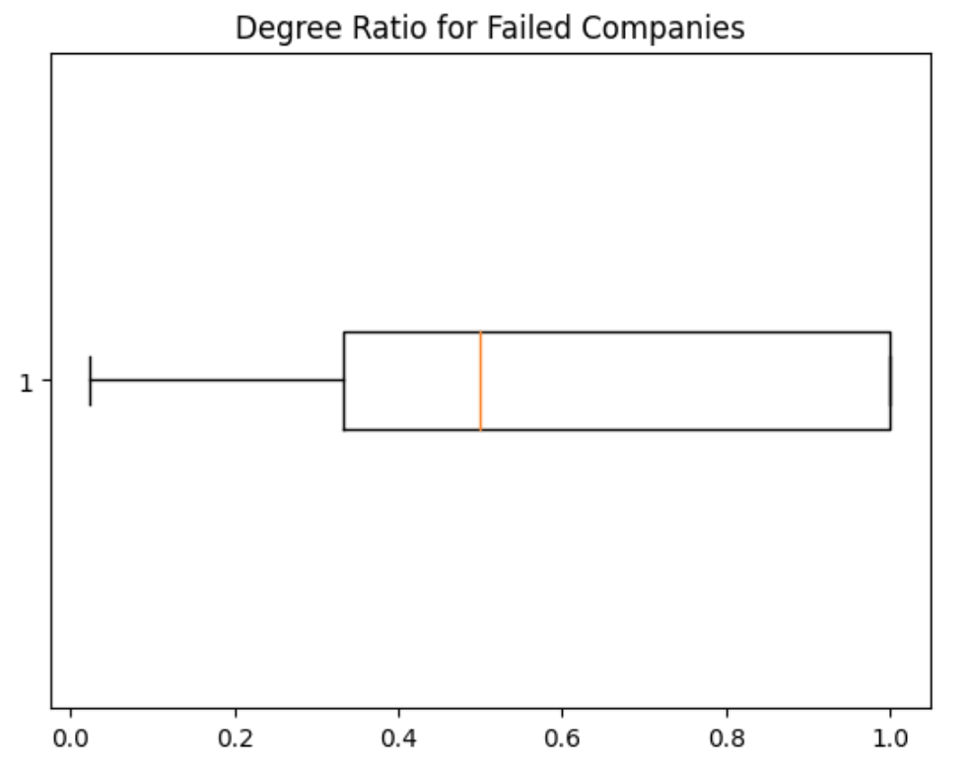
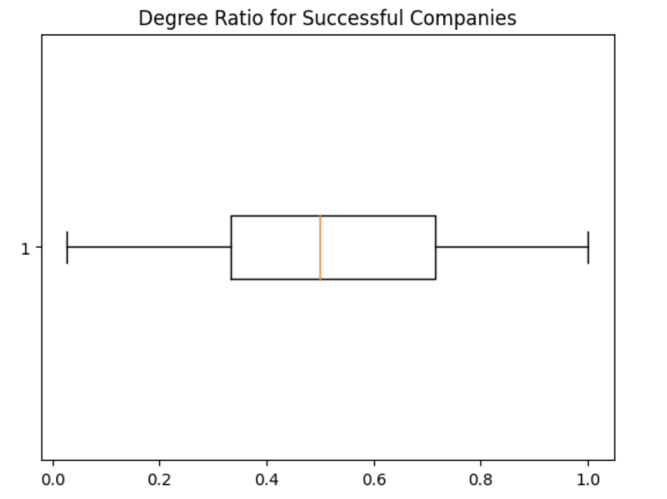
Key Takeaway
It seems that degree ratio does not have a large effect on success.
Failed companies appear to have a larger degree ratio on average. This may be affected by failed companies (especially since they would have less funding rounds) to have less documentation on who is involved with the company.
From an investor's perspective, it seems that one cannot use an entrepreneur's academic prowess as an indicator for investments.

Slide 12
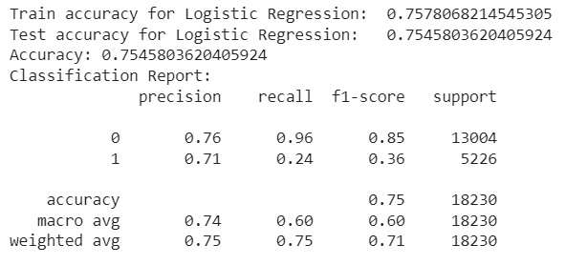
Logistic Regression
Implication/Insights
We noticed that regularization of Logistic regression wasn’t effective and all gave similar results.
Because of class-imbalance the logistic regression is more incentivized to over-classify true 0’s and under classify true 1’s
In this case, it seems that the model is effective at identifying "failure" companies.
The .96 metric tells us that our model is capable of identifying 96% of all actual failure cases.
The fact that recall is low for successful companies indicates that there might not be obvious reasons for a company to be successful within our metrics.

Slide 13
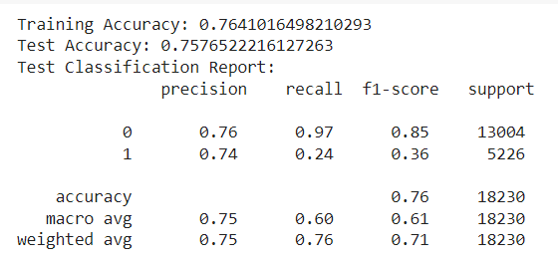
Decision Trees
Implications/Insights
Our accuracy went up with Decision trees.
Out of all of the hyperparameters, the best decision tree parameters were depth 10, minimum samples split 2, minimum sample leaves 16, no maximum number of features, and gini criteria.
This means that the decision tree was generally avoiding overfitting.
Similar recall and precision metrics indicate that our decision tree model, even though more complex, still has bias towards negative.
We don’t expect the decision tree to be linearly separable like the logistic regression.

Slide 14

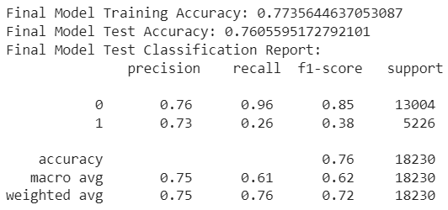
Random Forest
Implications/Insights
As all three models had very similar performance on recall, we see that the class imbalance certainly had a big effect.
The hyperparameters from the random forest indicate that the model was once again trying to regularize, with the number of estimators being high and the depth being low.
The fact that the precision remained very similar though, indicates that the logistic regression model was surprisingly effective.
Our models did improve with each iteration, meaning that the added complexity was useful.

Slide 15
Challenges
Our data was in different dataframes so we had to clean and merge many different tables.
Deciding which models to use to best analyze the data and present our data
Important feature selection through our large diversity in data.
Deciding our success criteria
Future Work
Analyze the data based on economic time period
Looking at creating some more specific features
Analyze how changes in regulations affect startup success rates across different regions and sectors, providing insights for policy advocacy and strategic adaptation
Use NLP to further analyze our data from the degree dataset.

Slide 16
Conclusion
The features that impact startup success are much more complex than we accounted for, and our select set of features was not a catch-all for startup success.
The low recall across all models indicates that our class imbalance significantly affected the outcomes, undermining the effectiveness of the predictive models.
The best-performing model was the random forest, achieving a 76% accuracy on the testing data. While this was the highest among our models, all tended to hover around the 75% accuracy mark, suggesting that our limited feature selection constrained model performance.
Given the current model performance and the challenges we faced with feature selection and class imbalance, we cannot reliably predict every instance of a startup’s success. We advise primarily using these models to filter out bad investments.

